Slide 1
Movie Recommendation System using Python
Presented by Roopa Sree

Slide 2
INTRODUCTION AND PURPOSE OF THE PROJECT:
Movie Recommendation System:
A movie recommendation system is an algorithm-based system designed to suggest films that users are likely to enjoy. It works by analyzing various factors, such as user ratings, viewing history, and the preferences of similar users, to generate personalized movie recommendations.
Purpose of the Project:
The objective of this project is to create a movie recommendation system that suggests movies based on user ratings. Using a dataset that includes movie titles, ratings, the number of ratings, and several recommendation fields, the system provides insights into which movies are highly rated and suggests similar films that users might enjoy.

Slide 3
Dataset Description:
Dataset Used: The project uses a Movie Recommendations dataset. This dataset is essential for understanding user preferences and making movie suggestions.
Key Columns:
Title: The name of the movie.
Rating: The average rating given to the movie by users.
Number of Ratings: The total number of user ratings for the movie.
First Recommendation: The first movie suggested based on the current movie.
Second, Third, Fourth Recommendations: Additional movie suggestions related to the current movie.
Purpose of the Dataset:
Context: The dataset helps analyze which movies are popular and highly rated.
Recommendations: The data allows the system to suggest movies that users might like based on their ratings and preferences.

Slide 4
Libraries and Tools Used
1. NumPy:
Purpose: A library for working with numbers and large datasets.
Usage: Helps with calculations and data processing in the project.
2. Pandas:
Purpose: A tool for managing and analyzing data.
Usage: Used to load and organize the movie data, making it easy to analyze ratings and recommendations.
3. Seaborn:
Purpose: A library for creating beautiful charts and graphs.
Usage: Used to make visualizations like bar plots and scatter plots to show patterns in the movie data.
4. Matplotlib:
Purpose: A basic plotting library for creating graphs.
Usage: Used alongside Seaborn to create clear and informative visualizations for the project.

Slide 5
Data Exploration
Before building the recommendation system, the dataset is carefully explored to ensure data quality and consistency. Here are some basic operations used in the project:
1. isnull()
Purpose: Identifies any missing values in the dataset.
Usage: Helps ensure that there are no gaps in the data that could affect the model.
2. describe()
Purpose: Provides summary statistics for numeric data, such as mean, standard deviation, and quartiles.
Usage: Offers a quick overview of the data's distribution and central tendencies.
3. head()
Purpose: Displays the first few rows of the dataset.
Usage: Useful for an initial inspection to understand the structure and content of the data.
4. drop(columns=['ColumnName'])
Purpose: Removes unnecessary columns from the dataset.
Usage: Cleans up the data by removing irrelevant columns, such as recommendations, when not needed.

Slide 6
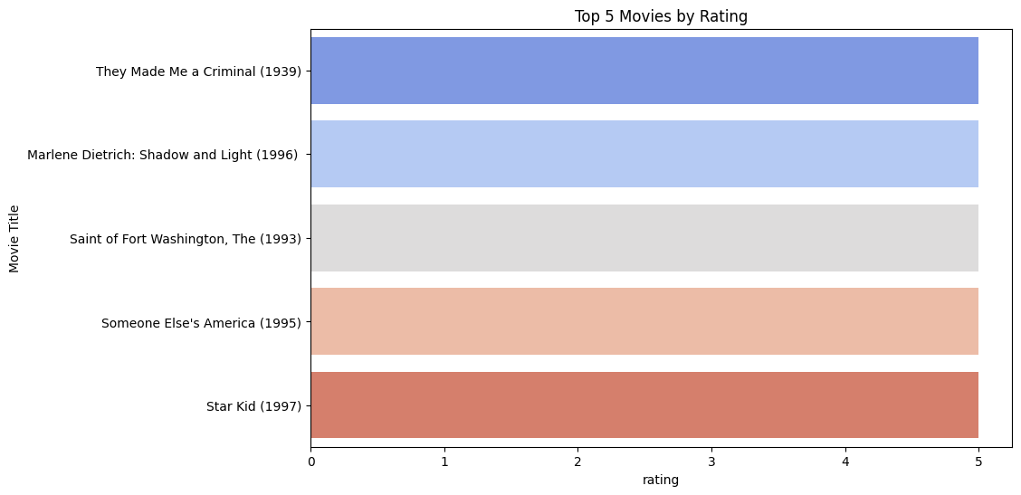
Top 5 Movies by Rating:
This bar chart displays the top 5 highest-rated movies. The x-axis shows the ratings, and the y-axis lists the movie titles. They Made Me a Criminal (1939)" has the highest rating, followed by "Marlene Dietrich: Shadow and Light (1996)" and others, allowing for a clear comparison of their ratings.

Slide 7
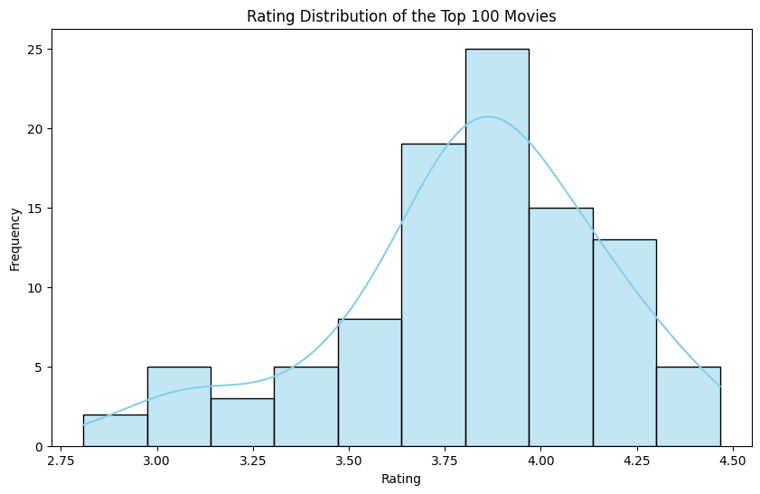
Rating Distribution of the Top 100 Movies
This graph shows how the ratings are spread out among the top 100 movies. Most movies have ratings between 3.5 and 4.0. The curve helps us see the overall pattern of ratings.

Slide 8
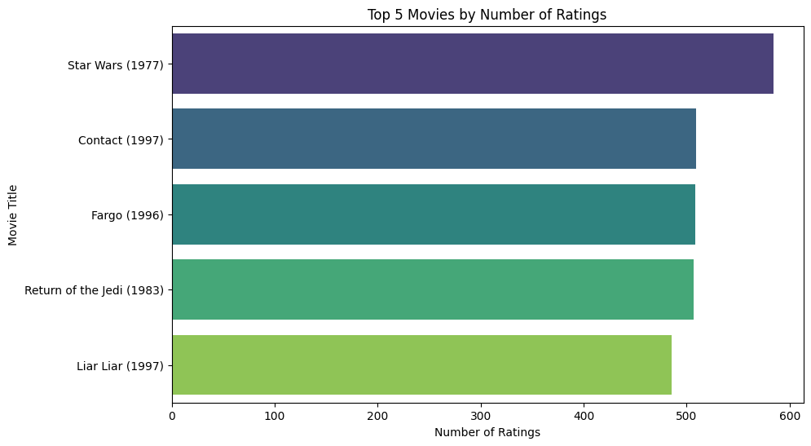
Top 5 Movies by Number of Ratings
This bar chart displays the top 5 movies with the highest number of ratings. "Star Wars (1977)" leads the list, followed by "Contact (1997)," "Fargo (1996)," "Return of the Jedi (1983)," and "Liar Liar (1997)." The number of ratings reflects the popularity and engagement of these movies.

Slide 9
Insights and Findings:
Top-Rated Movies: The analysis identified the top-rated movies in the dataset, with "They Made Me a Criminal (1939)" and "Marlene Dietrich: Shadow and Light (1996)" receiving the highest ratings.
2.Most Popular Movies: "Star Wars (1977)" had the highest number of ratings, indicating it was widely watched and reviewed.
3.Rating Distribution: The majority of the top 100 movies received ratings between 3.5 and 4.0, suggesting a generally favorable reception.
4.Recommendations Overview: The first and second recommendations provided for each movie often included well-known titles, indicating the effectiveness of the recommendation system in suggesting relevant content.
5.Consistency in Ratings: Movies with high ratings also tended to have a higher number of ratings, indicating consistency between popularity and quality.

Slide 10
Thank you

